Slide 1
8051 microcontroller
Introduction
Pin diagram
Architecture

Slide 2
Processor based system
Memory
Programs are fetches from memory
Power off, still data present (permanent)
Eg. Secondary mem (hard disk)
Main function of processor is to execute a program
ROM
Processor
Non Volatile
RAM
Power off, data lost (temporary)
Eg. Primary mem (RAM chip)
To connect processor,
memory and I/O ports
Volatile
System Bus
All these components are assembled within a single chip.this chip is called as microcontroller including timer
Address
Bus
I/O ports
Timer
Data
Bus
Control Bus
I/O devices

Slide 3
8051
Memory
ROM
Processor
Programs
4 KB
8 bit
RAM
Data
128 Bytes
RXD
Serial port
TXD
I/O ports
Timer
2, 16 bit
8 bit
P0
P1
P2
P3

Slide 4
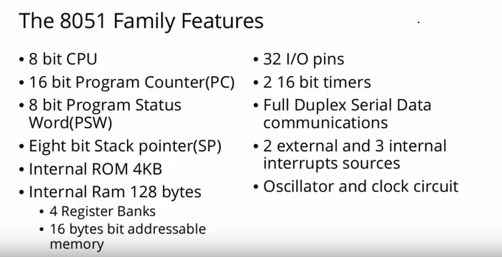

Slide 5
Pin Diagram of 8051
(40 pins)

Slide 6
XTAL 1
8 bit
parallel port
Alternate pins
8051 gets clock here
12 MHz
(12 millions per seconds)
P0.0 … PO.7 / AD0 – AD7
Processor
8 bit
P1.0 … P1.7 / X (no alternative)
XTAL 2
P2.0 … P2.7 / A15 – A 8
RESET
P3.0 … P3.7 / Alt fun of P3
ALE
Alternative functions of P3
P3.0
RXD
Serial port
(external access) EA
P3.1
TXD
P3.2
INT 0
(Prog status PSEN
enable)
External h/w ints
Ex. Playing game and call occurs
INT
ROM
P3.3
INT 1
P3.4
T0
Programs
4 KB
Timer CLK i/p
P3.5
T1
VCC
INT
RAM
P3.6
WR
GND
P3.7
RD
Data
128 Bytes
EXT
ROM
EXT
RAM

Slide 7
XTAL 1 & XTAL 2(crystal oscillator pins ): As VCC apply crystal start oscillating i.e. it gives continuous 0 and 1 i.e. clock pulses
RESET : This pin is used to reset the 8051. it only reset RAM not ROM
ALE : 8051 has 16 bit address bus and 8 bit data bus. When ALE = 0 , AD0-AD7 work as data bus and when ALE = 1 this lines work as a address
Serial port : bit by bit transfer / on bit at a time
example : mic, telephone
Disadv : slower than parallel port
Adv: cheaper, cost less than parallel port
TXD : To transfer data RXD : To receive data
Timer:
There are 2 ,16 bit timers are available in 8051
Timers are used to generate a delay by counting
To count timer requires clock pulses(to triggered)
T0 and T1 are used to give clock pulses to the timer
Oscillator clk is not used for timer because clk freq is 12 mhz which is too fast for timer,which only used to speed up the processor
BACK

Slide 8
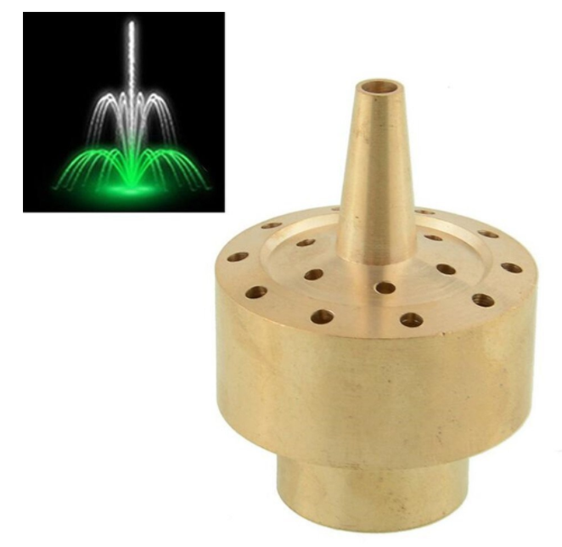
P0 to P3 Port :
8051 consist four parallel ports
All ports are bidirectional so they can be used as input or output.
Individual port is 8 bit so we can connect 8 devices to a single port
Hence we can connect total 32 devices by using 8051 port
Example for output port:
Example for Input port:
8 LEDS are connected to any port so LEDS can be made ON or OFF(light system) from 8 LEDS we want to glow last LED then simply pass 01 H
Musical fountains : LEDS are connected to fountain jets
Piano
All the ports are bit addressable (each line of port can be individually made 0 or 1)
example : 8 Fans are connected with 8 lines of any port of 8051, individually
single fan can be on or off without disturbing others.
Instructions used : SETB, CLR
SETB P0.0
CLR P0.0
BACK

Slide 9
EA : (External Access) :
8051 having internal RAM as well as external RAM
Internal RAM and external RAM both are works separately. Instructions for both are different
In case of external and Internal ROM either use both at a time or any one.
Whether to use internal ROM or not is the choice of programmer.
If we want to use internal ROM then first internal ROM comes and at the end of internal ROM external ROM begins
0000
0FFF
Internal ROM
EA = 1
1000
FFFF
External ROM
0000
Internal ROM
If we want to discard int ROM then only external ROM can be used by making EA=0
EA = 0
0000
External ROM
BACK

Slide 10
Why there are alternate function of port?
Why there is no separate address/data bus?
Answers :
You may not always need address / data bus
Processor and memory both are present inside the 8051
Only for external RAM or ROM address bus and data bus are required
BACK

Slide 11
8051
Add line is 16 bit
2¹⁶ = 2⁶ x 2¹⁰ = 64 KB
1.There fore ext RAM and ROM individually 64 Kb.
2. Addresses are duplicates for both
3. Control signals are used to differentiate
PSEN
RD
P3.6
P3.7
WR
To read data from ext ROM
EXT
ROM
64 KB
EXT
RAM
64 KB
For Ext RAM : RD , WR s/g are used
For Ext ROM : PSEN s/g is used
0000
FFFF
0000
FFFF
Example :
BACK

Slide 12
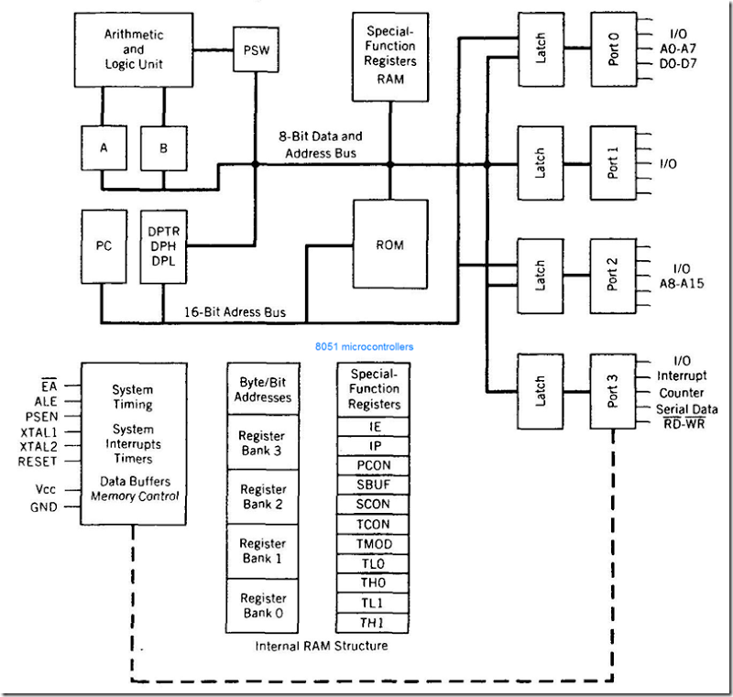

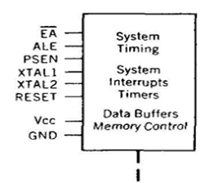
MEMORY
CPU
I/O ports, Timer

Slide 13
8051 reads the data from external RAM at location 4000
8051
0000
4000 | 25
FFFF
0000
4000 | 36
FFFF
AD = 4000
D = 25
C = RD
EXT
RAM
EXT
ROM
Sequence :
1. For above example both 4000 location gets selected by address bus
2. Control signal generated by RD = 0
3. Data 25 will read by 8051 through data bus

Slide 14
Data Registers
ALU performs the operations
2
Status will store
into PSW
ALU
8 bit
4
PSW
8 bit
A & B gives operands to
ALU
1
3
A
8 bit
B
8 bit
Result store
into reg A
BACK

Slide 15
Data Registers
Reg A : (Accumulator) : it is used to hold the first operand as well as result. It will accumulating the result there fore it is called as accumulator
Reg B : it is used with multiplication and division instructions i.e. MUL AB
ALU : A and B gives operand to the ALU, then ALU will perform all arithmetic, logical operations on given operand and result will store into accumulator and status will store into PSW.
PSW : (Program Status WORD) :
PSW contains the status of the result after each operation performed by ALU.
Working of PSW is similar with flag register of processor.
PSW can changed by ALU
In case of 8051 PSW can also modified by programmer(i.e. mov psw, 10h)
BACK

Slide 16
Address Registers
PC(Program Counter):
PC is used to hold the address of next instruction.
It is always used to hold the address of an instruction
PC is 16 bit register
Address
Data
PC
0000
0001
FFFF
PC will autoincrement by 1
PC + 1
Next

Slide 17
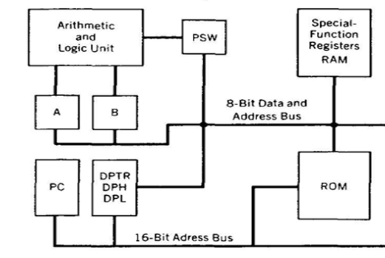
These registers contains data
8 bit
8 bit
Address
Data
Internal
RAM
128 Bytes
Whatever
contents of this line is available
for programmer
Internal
ROM
4 KB
16 bit
8 bit
These registers contains address
BACK

Slide 18
Address Registers
DPTR (Data Pointer 16 bit):
Data pointer is used to gives the address of data
Data can be accessed by following manner
a. In sequence b. In reverse c. Random
It is not autoincrement
It is control by programmer
------
------
------
------
------
------
------
------
------
DTPR gives the 16 bit address of 8 bit data because 8051 has 16 bit address
To modify DPTR we have to perform 16 bit operation because DPTR is 16 bit
But 8051 works on 8 bit data it means 8051 performs 8 bit operation in one cycle
So to modify DPTR it requires more than one cycle
To avoid above problem two registers are used i.e. DPH and DPL
Example :

Slide 19
DPH (data pointer higher byte) & DPL (data pointer lower byte) :
Address
Data
If DPTR is 1234 and wants to increment by 1
It means actually we want to increment lower byte
So instead of increment whole number only lower byte needs to perform operation
There fore choice is given to programmer to increment lower byte or higher byte individually
DTPR
1 2 3 4 H L
1 2 3 5 H L
FFFF
DTPR + 1
So programmer can use full DTPR for 16 bit operation or DPH / DPL for 8 bit operation
BACK

Slide 20
8 bit
8 bit
Address
Data
Internal
RAM
128 Bytes
A
8 bit
D
8 bit
D - 8 bit
A
16 bit
Internal
ROM
4 KB
16 bit
8 bit
NEXT

Slide 21
Internal RAM
8 bit
8 bit
Address
Data
00 H
01 H
02 H
.
.
7F H
00 H
01 H
…
…
7F H
0000 0000
0000 0001
…
…
0111 1111
Size of the internal RAM is 128 bytes
2⁷ = 128
7 bits are used to generate the address
Internal ROM
16 bit
8 bit
Address
Data
Size of the internal ROM is
4 KB
4 KB = 2² x 2¹⁰
12 bits are used to generate the address
0000 H
0001 H
0002 H
.
.
0FFF H
0000 H
0001 H
…
…
0FFF H
0000 0000 0000 0000
0000 0000 0000 0001
…
…
0000 1111 1111 1111
BACK
Next

Slide 22
Before latch red color line is data bus, Data bus only carries data not store
After latch it becomes port , So latch is used to store data

Slide 23
PSEN = 1
8051
0000
3000 | 46
FFFF
0000
3000 | 55
FFFF
RD = 0
EXT
RAM
EXT
ROM

